Slide 1
Vocabulary
Stage XV

Slide 2

alius, alia, aliud
ANOTHER
other; another
CLC XV

Slide 3

aqua
aquam
(f.)
water
CLC XV

Slide 4

claudere
claudō
clausī
close; shut; block
CLC XV

Slide 5

commodus/a/um
convenient
CLC XV

Slide 6

dēbēre
dēbeō
dēbuī
ought; owe
CLC XV

Slide 7
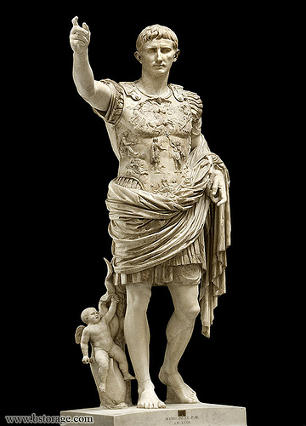
effigiēs
effigiem
(f.)
image; statue
CLC XV

Slide 8
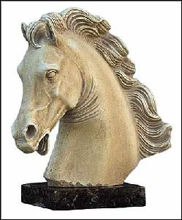
equus
equum
(m.)
horse
CLC XV

Slide 9
etiam
EVEN
even; also
CLC XV

Slide 10


frāctus/a/um
broken
CLC XV

Slide 11

impedīre
impediō
impedīvī
delay; hinder
CLC XV

Slide 12
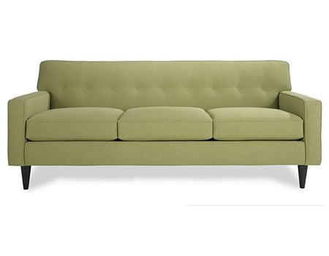
lectus
lectum
(m.)
couch; bed
CLC XV

Slide 13
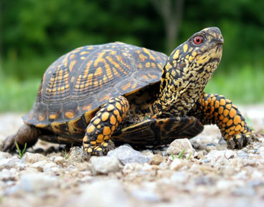

lentē
slowly
CLC XV

Slide 14
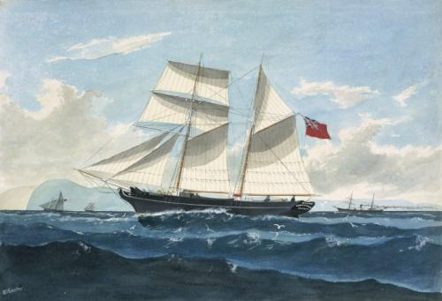
mare
mare
(n.)
sea
CLC XV

Slide 15


miser/misera/miserum
miserable; wretched
CLC XV

Slide 16

nauta
nautam
(m.)
sailor
CLC XV

Slide 17
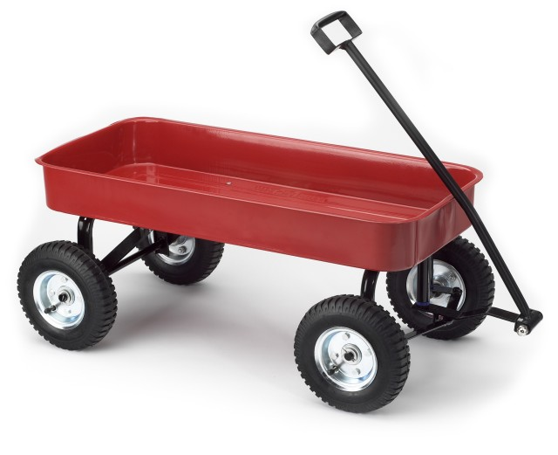
plaustrum
plaustrum
(n.)
wagon; cart
CLC XV

Slide 18

praeesse
praesum
praefuī
be in charge of
CLC XV

Slide 19
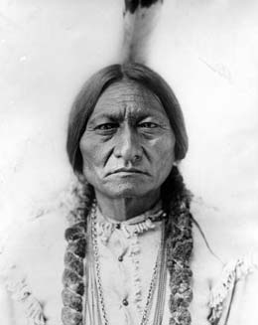

prīnceps
prīncipem
(m.)
chief; chieftain
CLC XV

Slide 20
quī/quae/quod
WHO
who; which
CLC XV

Slide 21

redīre
redeō
rediī
return; go back
CLC XV

Slide 22
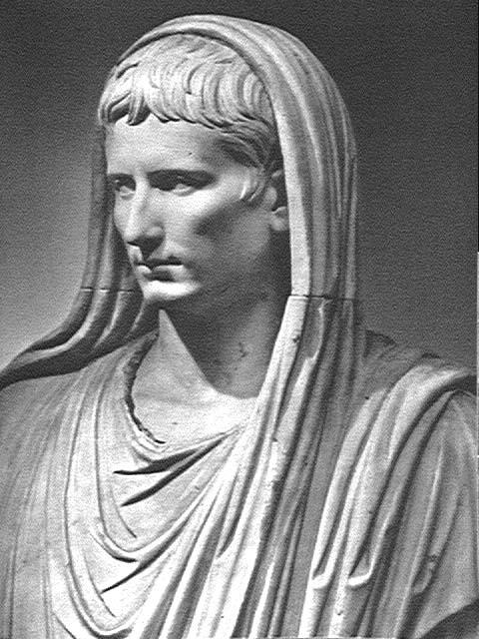
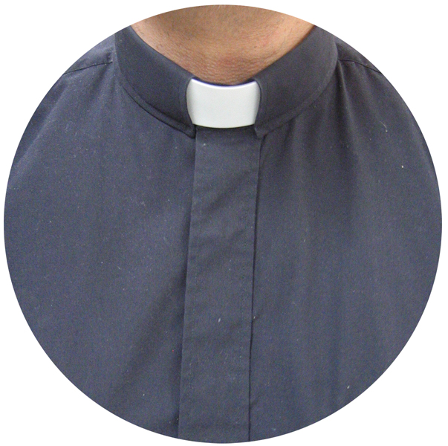
sacerdōs
sacerdōtem
(m.)
priest
CLC XV

Slide 23

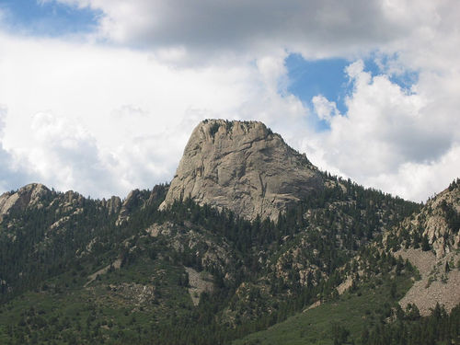
saxum
saxum
(n.)
rock
CLC XV

Slide 24

tenēre
teneō
tenuī
hold
CLC XV

Slide 25

unda
undam
(f.)
wave
CLC XV

Slide 26

vincere
vincō
vīcī
win
CLC XV

